Slide 1
Trust shield - Safety & Smart Emergency Assistance Website

Slide 2
Abstract
Trust Shield is a web-based safety and smart emergency assistance system developed to help individuals during dangerous or emergency situations. The platform is mainly designed for women, children, and travelers who may face risks such as harassment, accidents, getting lost, or medical emergencies. Trust Shield provides a one-click SOS feature that sends instant alerts with real-time location to trusted contacts, enabling quick help.
The system also includes journey tracking, safe route guidance, and quick incident reporting to improve user safety. Users can upload evidence such as photos, videos, or audio recordings and generate police complaint documents when required. Additional features like nearby hospital and police station search, self-defense tutorials, and safety awareness tools make the platform a complete digital safety companion. By integrating modern web technologies and location services, Trust Shield aims to reduce emergency response time and enhance personal security in real-life situations.

Slide 3
Existing System overview
Depends mainly on emergency phone calls
No real-time location sharing
Incident reporting is manual and time-consuming
Lacks journey tracking and safe route features
Evidence collection is not integrated
Safety tools are scattered across multiple apps

Slide 4
Proposed system overview
Provides one-click SOS alerts with live location
Sends alerts to trusted emergency contacts
Supports journey tracking for safe travel
Enables quick incident and crime reporting
Allows evidence upload (photo, video, audio)
Shows nearby police stations and hospitals

Slide 5
System Architecture
The Trust Shield system architecture follows a multi-tier (layered) architecture that ensures scalability, security, real-time communication, and efficient emergency response. The system integrates frontend interfaces, backend services, databases, third-party APIs, and optional AI/ML modules to deliver a complete safety solution.
Presentation Layer (Frontend)
Components:
User Dashboard (Web Interface)
SOS Button Interface
Journey Tracker UI
Incident & Crime Reporting Forms
Evidence Upload Interface
Period & Health Tracker
Missing Person Information Board

Slide 6
Technologies (Example):
PYTHON,HTML, CSS, JavaScript
React.js
Map APIs (Google Maps / OpenStreetMap)
Function:
Captures user input
Displays alerts, maps, and safety information
Sends requests to backend services
Missing Person Information Board
Safe Route & Danger Zone Map View

Slide 7
2. Application Layer (Backend Server)
This is the core logic layer that handles all system operations.
Components:
User Authentication & Authorization Module
SOS Alert Management Service
Journey Tracking Service
Incident & Crime Report Management
Police Complaint PDF Generator
Emergency Notification Service
Evidence Processing Module

Slide 8
Quick Alert Handler
Technologies (Example):
Node.js / Express.js or Python Flask / Django
RESTful APIs
Web Sockets (for real-time alerts)
Function:
Processes requests from frontend
Executes emergency workflows
Communicates with databases and external services

Slide 9
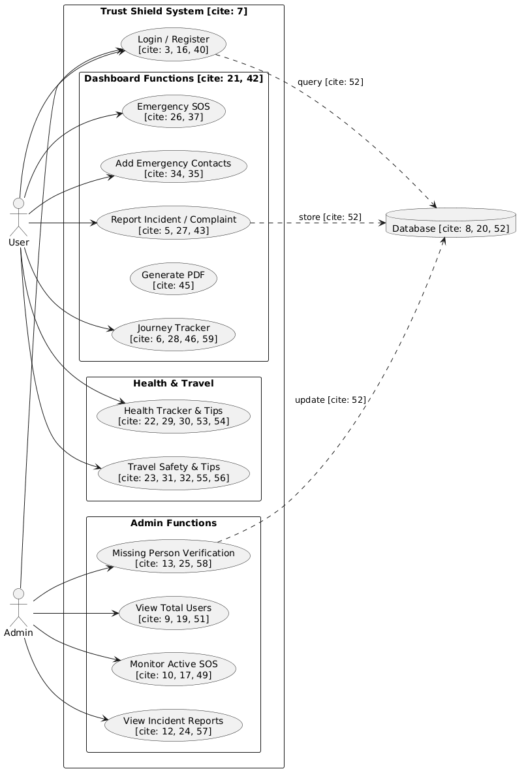
Use case diagram

Slide 10
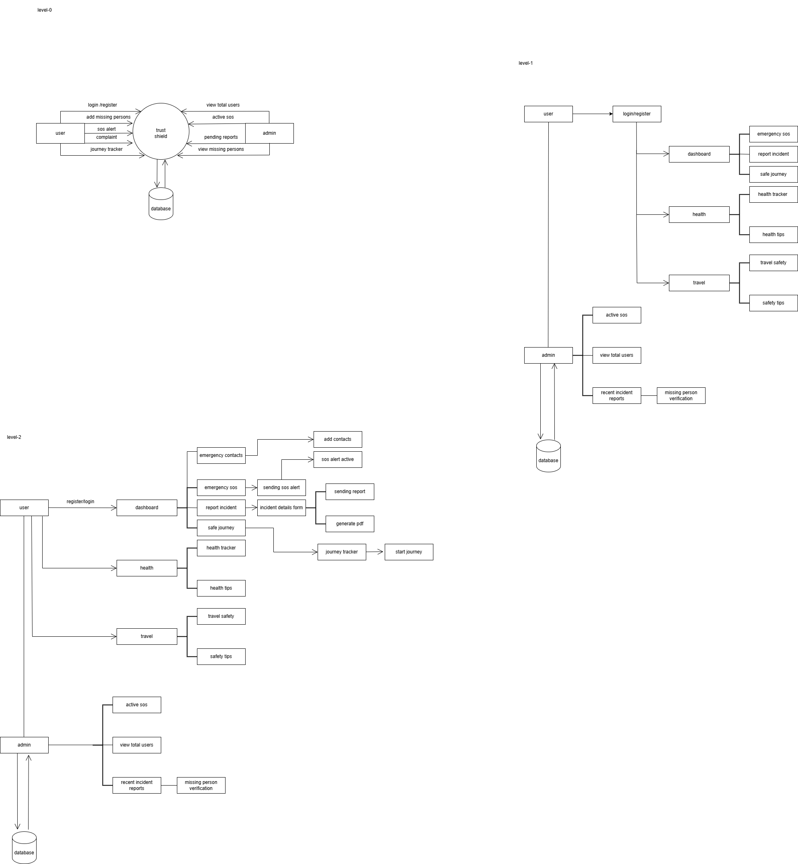
Dataflow Diagram
Level-0

Slide 11
level-1

Slide 12
Level-2

Slide 13
scope
Develop a web-based safety assistance system
Provide SOS alerts with live location sharing
Enable journey tracking and safe route guidance
Support incident reporting and evidence upload
Show nearby hospitals and police stations
Ensure secure user data and authentication

Slide 14
Objectives
To provide instant help during emergencies
To improve personal safety and awareness
To reduce emergency response time
To enable real-time location-based alerts
To offer a single integrated safety platform
To ensure reliable and user-friendly operation

Slide 15
Conclusion
Trust Shield is a smart and reliable web-based safety platform that provides quick emergency assistance and real-time location support. By integrating SOS alerts, incident reporting, and safety features into a single system, it helps improve personal security and reduce response time during emergencies. The project serves as an effective digital safety companion for real-life situations.

